Slide 1

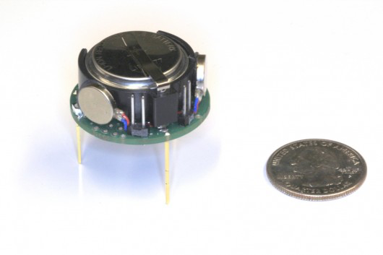
Robotic Swarm Control Lab Dr. Aaron T. Becker, Shiva Shahrokhi
one kilobot
A “big” robot in our lab
One hundred kilobots pushing a toy piano
Notes:
I'm Shiva Shahrokhi, a senior PhD in Dr. Aaron Becker's Robotics Swarm Control Lab
Our lab focuses on robotics and controls. We are specifically interested in controlling large numbers of small, simple robots to do things big robots can’t.
Things like deliver drugs to locations deep inside the human body. These tiny robots are usually controlled by the same shared signal. That signal can be a shared magnetic field or a chemical gradient.
This video shows some of the “big” robots in our lab. We programmed them to move toward the brightest light in the room, so we can control them by moving that light source around.
These kilobots are bigger than the robots we’re working on
----- Meeting Notes (7/21/15 14:46) -----
robots for our target applications

Slide 2
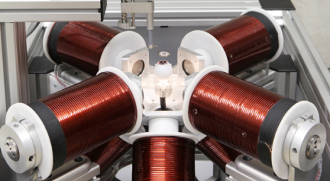
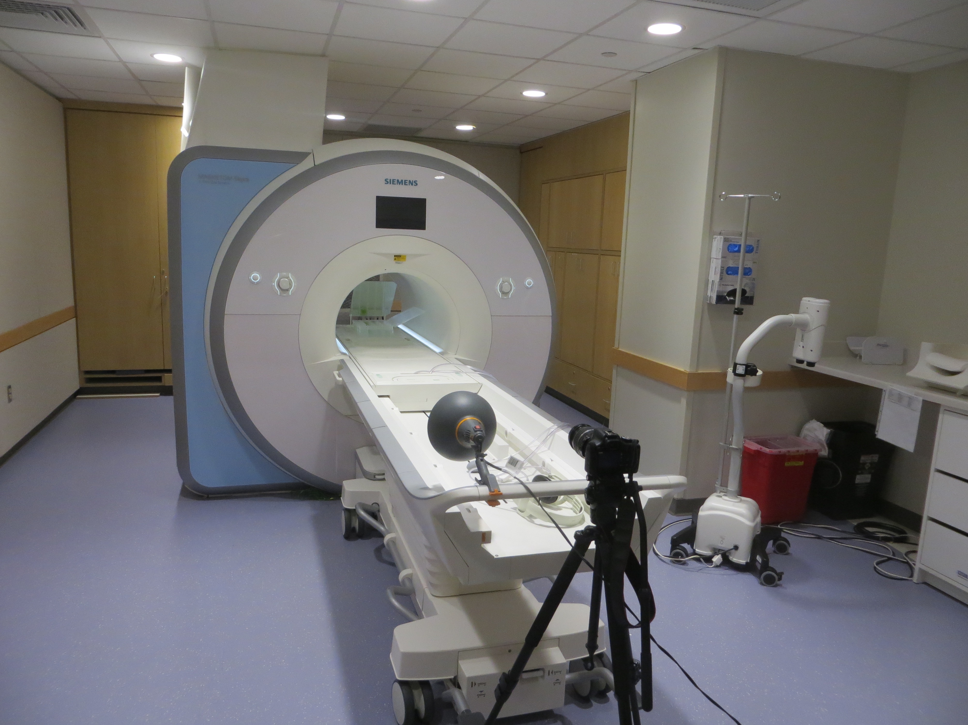
Moving tiny particles with a controllable magnetic field
Notes:
One of the big challenges for feedback control of tiny robots is sensing.
We’d like Sensing technologies that can see through tissue and resolve to the microscale (10 micro meters or less).
We’ve been using MRI for sensing, but it is expensive and large. We’re excited to talk about new sensing modalities.

